Slide 1


Conceptual diagram and research questions
1b
Consumption diversity
1a
System diversity
Catch diversity
1c
Sold diversity
2a
2b
Ecological traits
Abundance, size, nutrient content
Household characteristics
Demographics, income, market access
1. How does system diversity shape a) catch, b) consumption, and c) sale diversity?
2. How do a) ecological traits and b) household characteristics shape biodiversity utilization?

Slide 2
1a: How does system diversity relate to catch diversity?
1b
Consumption diversity
1a
System diversity
Catch diversity
1c
Sold diversity
2a
2b
Ecological traits
Abundance, size, nutrient content
Household characteristics
Demographics, income, market access
Notes:
Slope = 0.385. When the number of species in the system goes up by 1, the number of species caught goes up by 0.38.
This is the relationship without controlling for things that you might think influence this relationship such as how many people are fishing, how much people are fishing, their preference for eating fish versus other things, their ability to sell fish, etc.

Slide 3
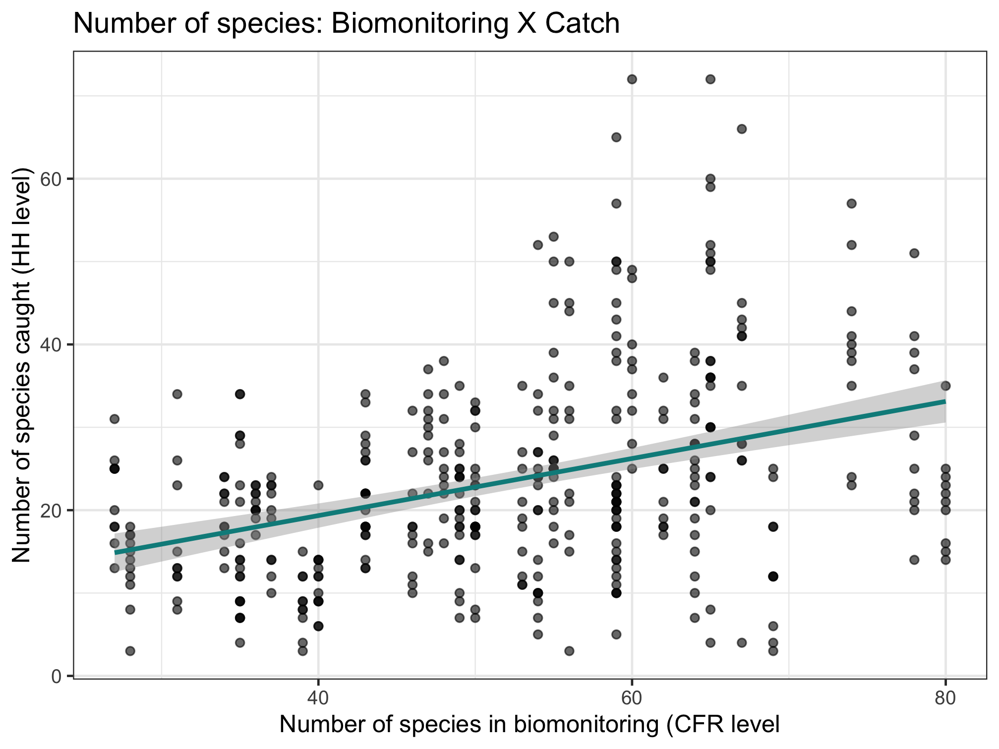
1a: How does system diversity relate to catch diversity?
1b
Consumption diversity
1a
System diversity
Catch diversity
1c
Slope = 0.385
Sold diversity
2b
A lot of variation!
Notes:
Slope = 0.385. When the number of species in the system goes up by 1, the number of species caught goes up by 0.38.
This is the relationship without controlling for things that you might think influence this relationship such as how many people are fishing, how much people are fishing, their preference for eating fish versus other things, their ability to sell fish, etc.
There is a lot of variation as number of species in the CFR increases. Some households catch a lot of those species, while others catch very few. In later questions we try to unpack this.

Slide 4
1b: How does catch diversity relate to consumption diversity?
1b
Consumption diversity
1a
System diversity
Catch diversity
1c
Sold diversity
2a
2b
Ecological traits
Abundance, size, nutrient content
Household characteristics
Demographics, income, market access
Notes:
Slope = 0.979. When the number of species caught goes up by 1, the number of species consumed goes up by nearly 1.
Relationship between catch and consumption diversity is very very close!

Slide 5
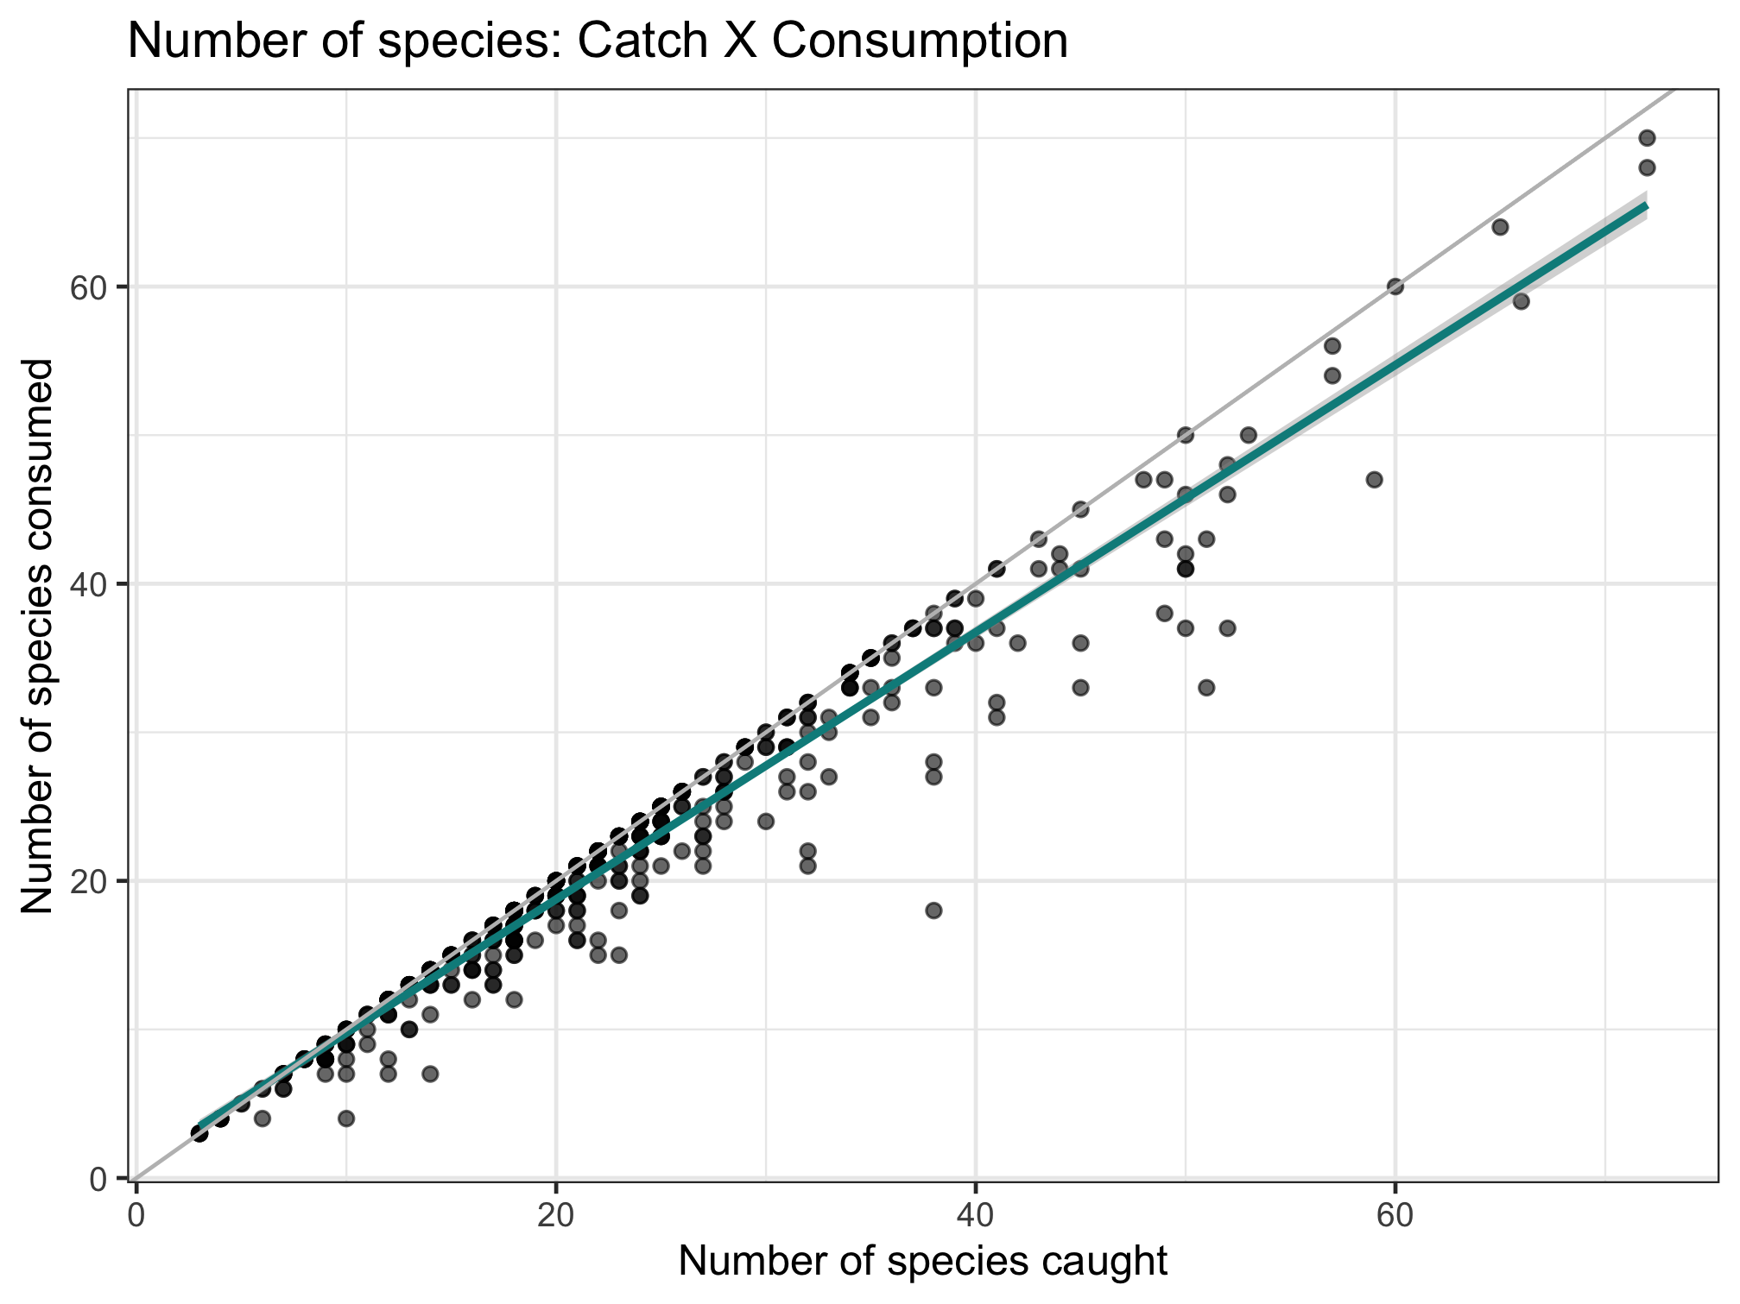
1b: How does catch diversity relate to consumption diversity?
1b
Consumption diversity
1a
System diversity
Catch diversity
Sold diversity
2b
Slope = 0.979!
Notes:
Slope = 0.979. When the number of species caught goes up by 1, the number of species consumed goes up by nearly 1.
Relationship between catch and consumption diversity is very very close!
This is the relationship without controlling for things that you might think influence this relationship such as how many people are fishing, how much people are fishing, their preference for eating fish versus other things, their ability to sell fish, etc.

Slide 6
1c: How does catch diversity relate to diversity of fish sold?
1b
Consumption diversity
1a
System diversity
Catch diversity
1c
Sold diversity
2a
2b
Ecological traits
Abundance, size, nutrient content
Household characteristics
Demographics, income, market access

Slide 7
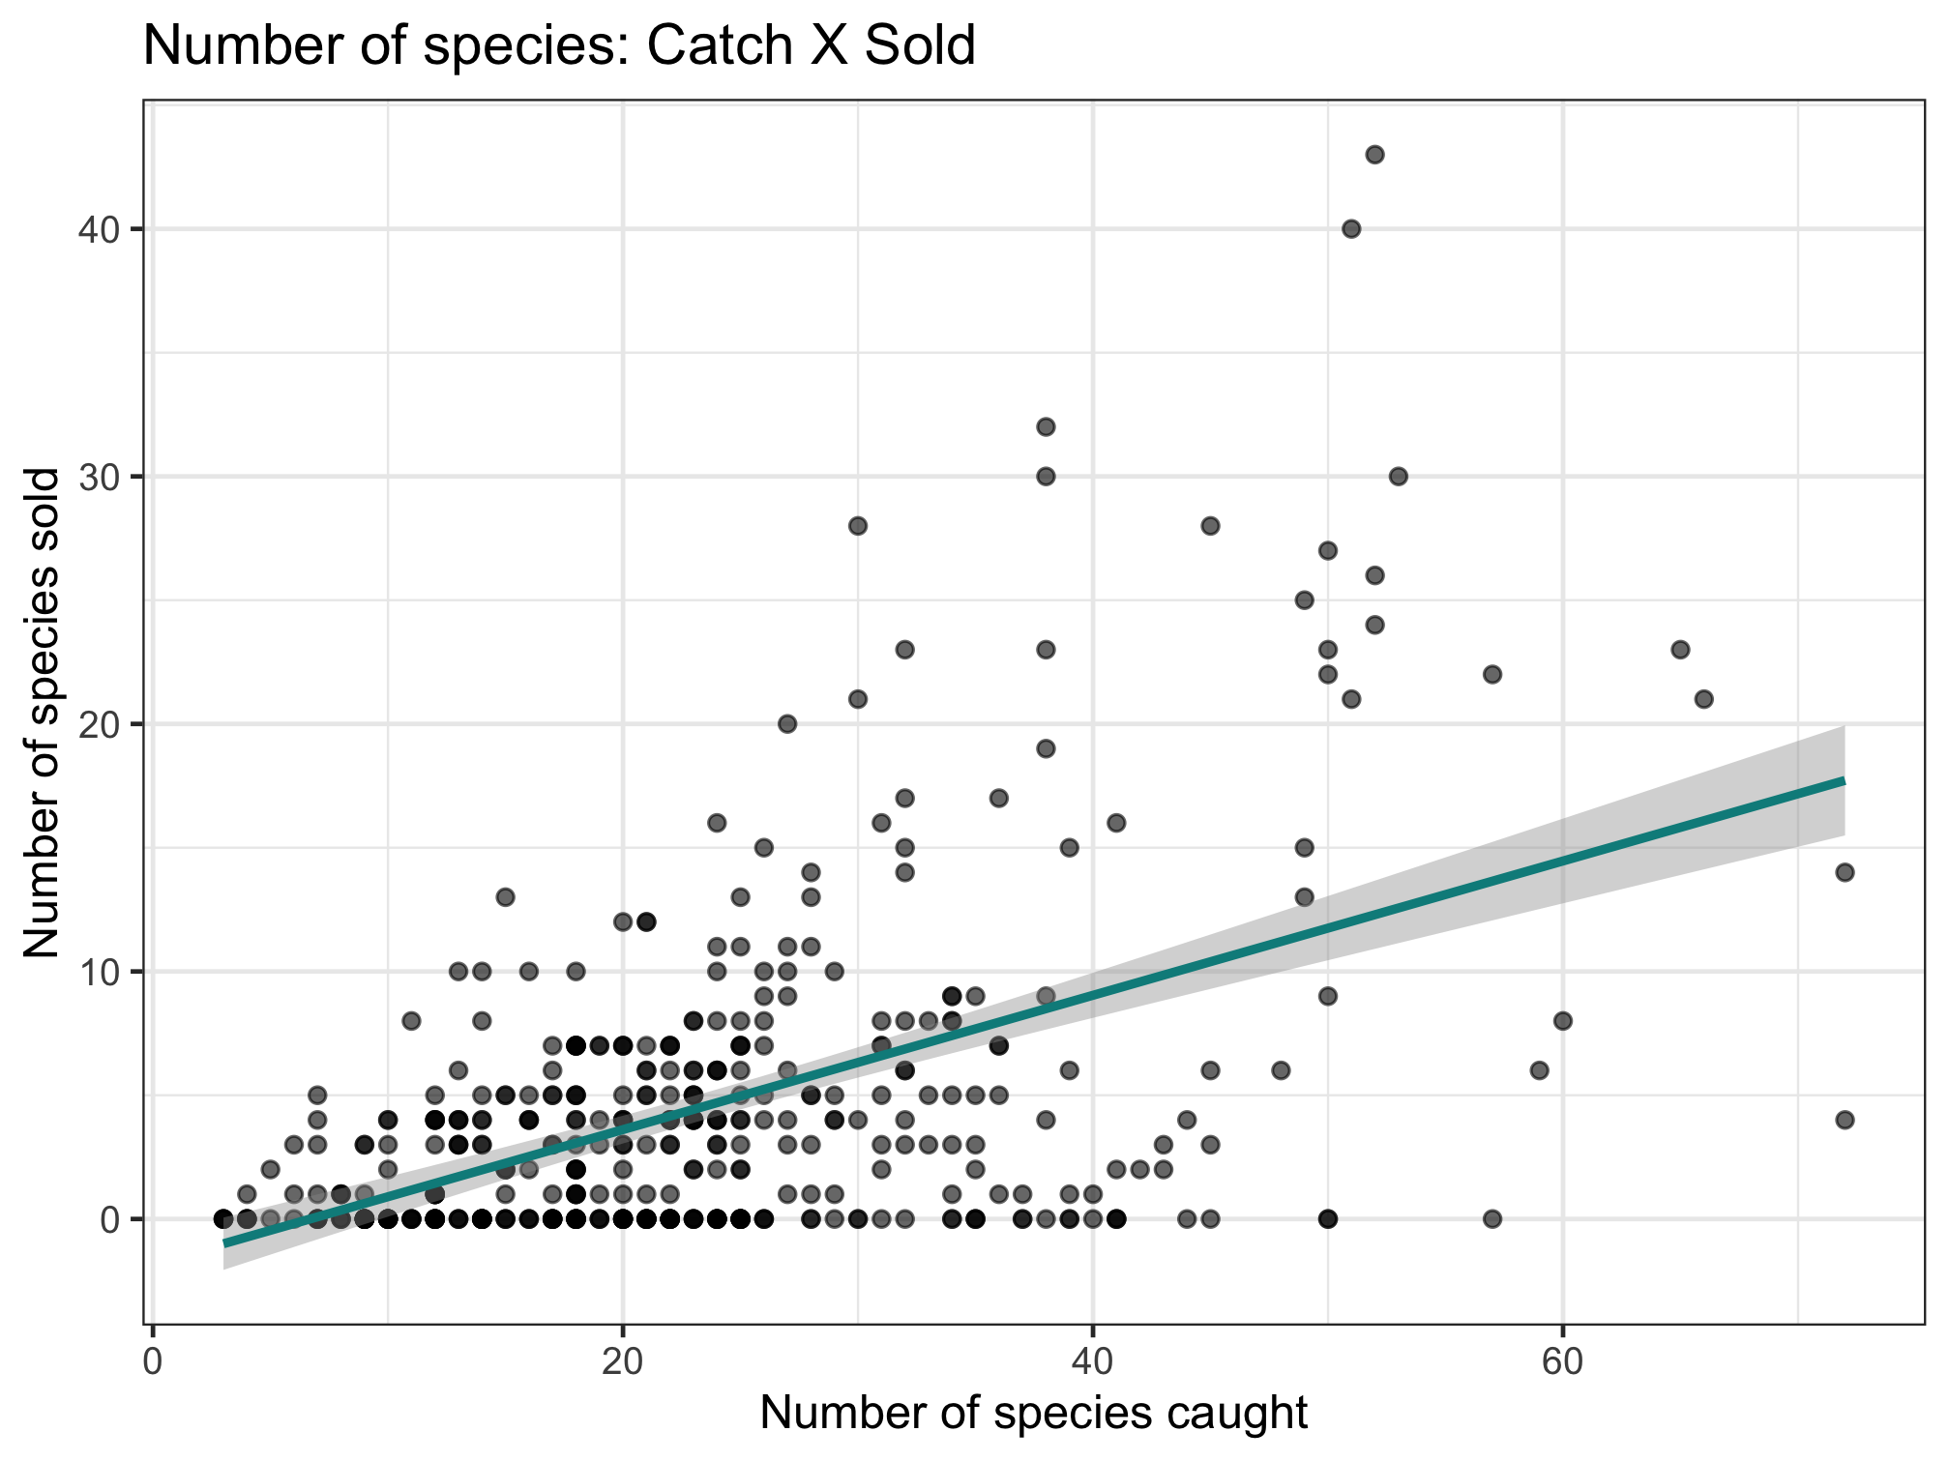
1c: How does catch diversity relate to the diversity of fish sold?
1b
Consumption diversity
1a
System diversity
Catch diversity
1c
Sold diversity
Slope = 0.397
A lot of people never sell fish
Notes:
Slope = 0.397. When the number of species caught goes up by 1, the number of species consumed goes up by about 0.4.
Relationship between catch and consumption diversity is very very close!

Slide 8
2a: What role do ecological traits play in these relationships?
1b
Consumption diversity
1a
System diversity
Catch diversity
1c
Sold diversity
2a
2b
Ecological traits
Abundance, size, nutrient content
Household characteristics
Demographics, income, market access

Slide 9
2a: What role do ecological traits play in these relationships?
Nutrient content: Minimum biomass required to achieve 50% of the RDA for 6 nutrients
The amount of a given fish portfolio that someone would have to eat
Recommended daily allowance for children under 5
We use 50% because we know people get nutrition from foods besides fish
Protein
Iron
Zinc
Calcium
Vitamin A
Omega-3
Takeaway: The larger this value is, the less nutritious a fish portfolio is.
Large value = less nutritious.
Small value = more nutritious.

Slide 10
2a: What role do ecological traits play in these relationships?
Nutrient content: Minimum biomass required to achieve 50% of the RDA for 6 nutrients
Body size: Biomass-weighted mean total length
Different portfolios contain species of different sizes.
Mean is weighted by amount of each species caught.
The length of a fish species

Slide 11
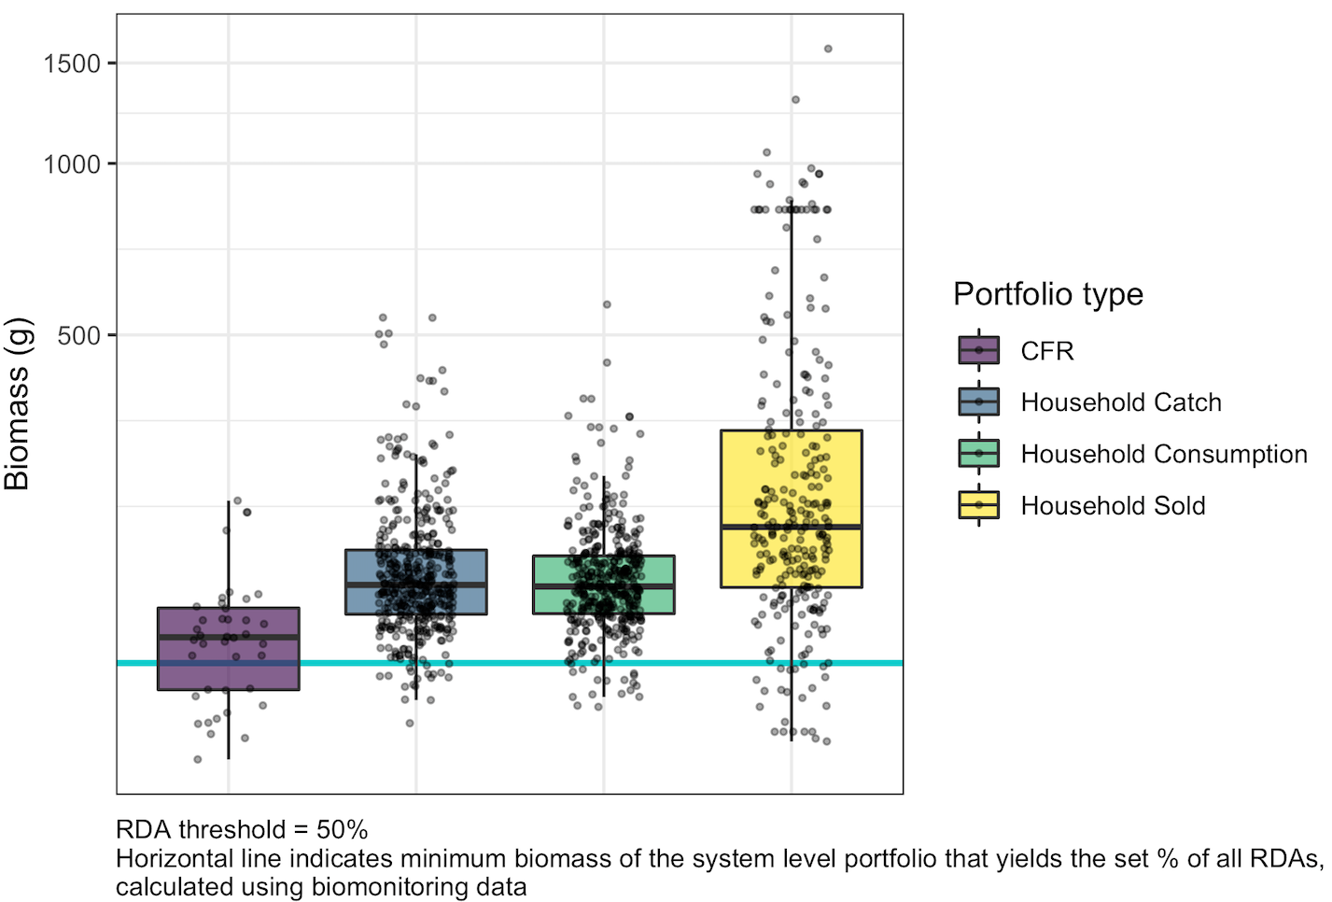
2a: What role do ecological traits play in these relationships?
Nutrient content: Minimum biomass required to achieve 50% of the RDA for 6 nutrients

Slide 12
2a: What role do ecological traits play in these relationships?
Nutrient content: Minimum biomass required to achieve 50% of the RDA for 6 nutrients
Median: 147 g
Min: 89.3 g
Max: 256 g
CFR-level:
Each point equals the minimum biomass for a given CFR’s species portfolio

Slide 13
2a: What role do ecological traits play in these relationships?
Nutrient content: Minimum biomass required to achieve 50% of the RDA for 6 nutrients
Median: 147 g
Min: 89.3 g
Max: 256 g
182 g
104 g
536 g
Household-level catch:
Each point equals the minimum biomass for a given household’s catch portfolio

Slide 14
2a: What role do ecological traits play in these relationships?
Nutrient content: Minimum biomass required to achieve 50% of the RDA for 6 nutrients
Median: 147 g
Min: 89.3 g
Max: 256 g
182 g
104 g
536 g
181 g
111 g
565 g
Household-level consumption:
Each point equals the minimum biomass for a given household’s consumption portfolio

Slide 15
2a: What role do ecological traits play in these relationships?
Nutrient content: Minimum biomass required to achieve 50% of the RDA for 6 nutrients
Median: 147 g
Min: 89.3 g
Max: 256 g
182 g
104 g
536 g
181 g
111 g
565 g
230 g
1589 g
96 g
Household-level sale:
Each point equals the minimum biomass for a given household’s sale portfolio

Slide 16
2a: What role do ecological traits play in these relationships?
Nutrient content: Minimum biomass required to achieve 50% of the RDA for 6 nutrients
Median: 147 g
Min: 89.3 g
Max: 256 g
182 g
104 g
536 g
181 g
111 g
565 g
230 g
1589 g
96 g
Minimum biomass of system-level portfolio (132 g)

Slide 17
2a: What role do ecological traits play in these relationships?
Nutrient content: Minimum biomass required to achieve 50% of the RDA for 6 nutrients
Remember: larger values → less nutritious fish portfolio
System level portfolio appears most nutritious
Catch and consumption portfolios
Very similar to each other
Less nutritious than system level (and CFR)
Sold portfolio
Overall less nutritious
Much more variation
CFR Catch Consumption Sold
Median: 147 g
Min: 89.3 g
Max: 256 g
182 g
104 g
536 g
181 g
111 g
565 g
230 g
1589 g
96 g
132 g
Notes:
Means are very close to the median, except for sold where mean = 319 (median = 230)

Slide 18
Notes from October 2022

Slide 19
Working diagram and data sources
Nutrient diversity in the food system
Sold diversity
System diversity
Catch diversity
Consumption diversity
Nutrient diversity in household diets
Biomonitoring data
CFR-level
Catch and consumption monitoring data
Household-level
Nutrient database
Species-level

Slide 20

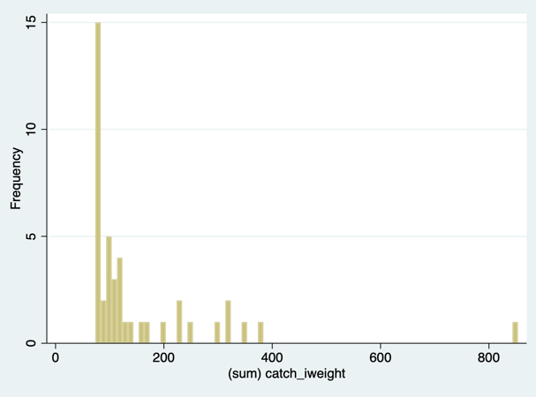
Nutrient diversity in the food system
Sold diversity
Slope = 0.384
System diversity
Catch diversity
Consumption diversity
Nutrient diversity in household diets

Slide 21
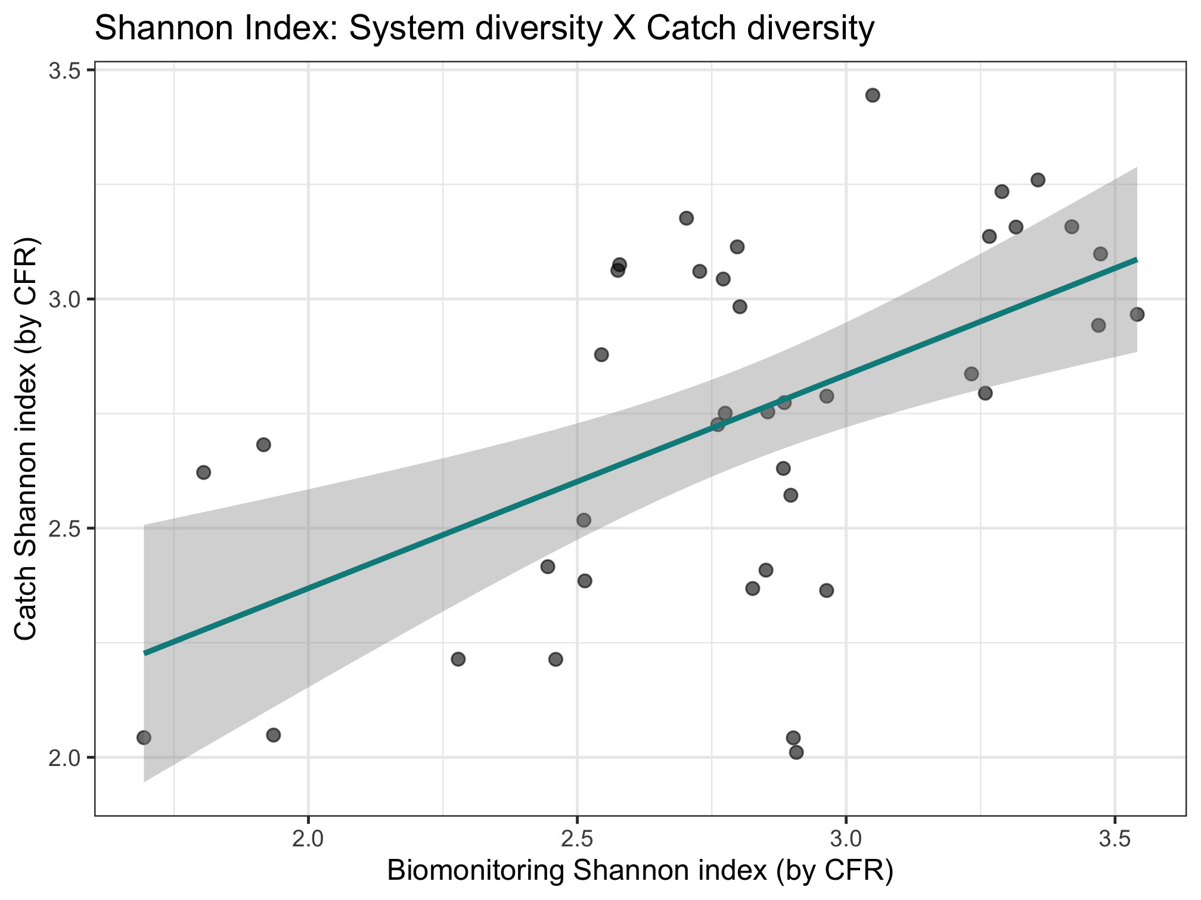
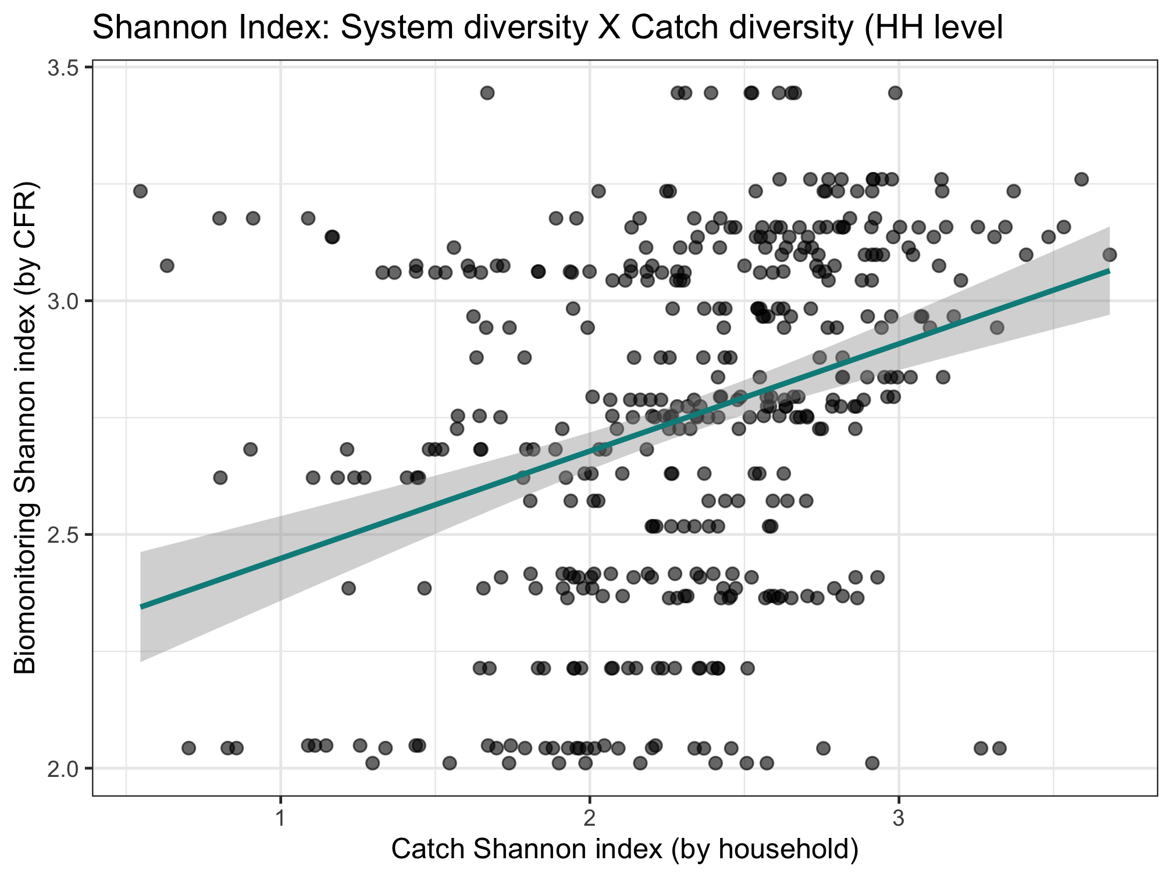
Color code by CFR type, maybe CFR size
Nutrient diversity in the food system
Sold diversity
Slope = 0.486
System diversity
Catch diversity
Consumption diversity
Nutrient diversity in household diets
Slope = 0.376

Slide 22

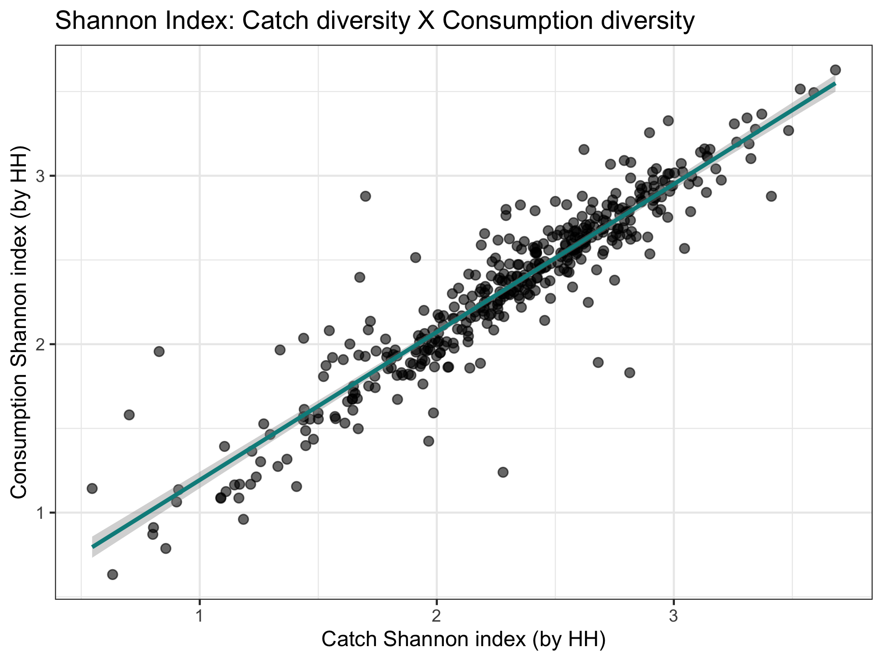
Nutrient diversity in the food system
Sold diversity
Slope = 0.979
System diversity
Catch diversity
Consumption diversity
Nutrient diversity in household diets
Slope = 0.924

Slide 23
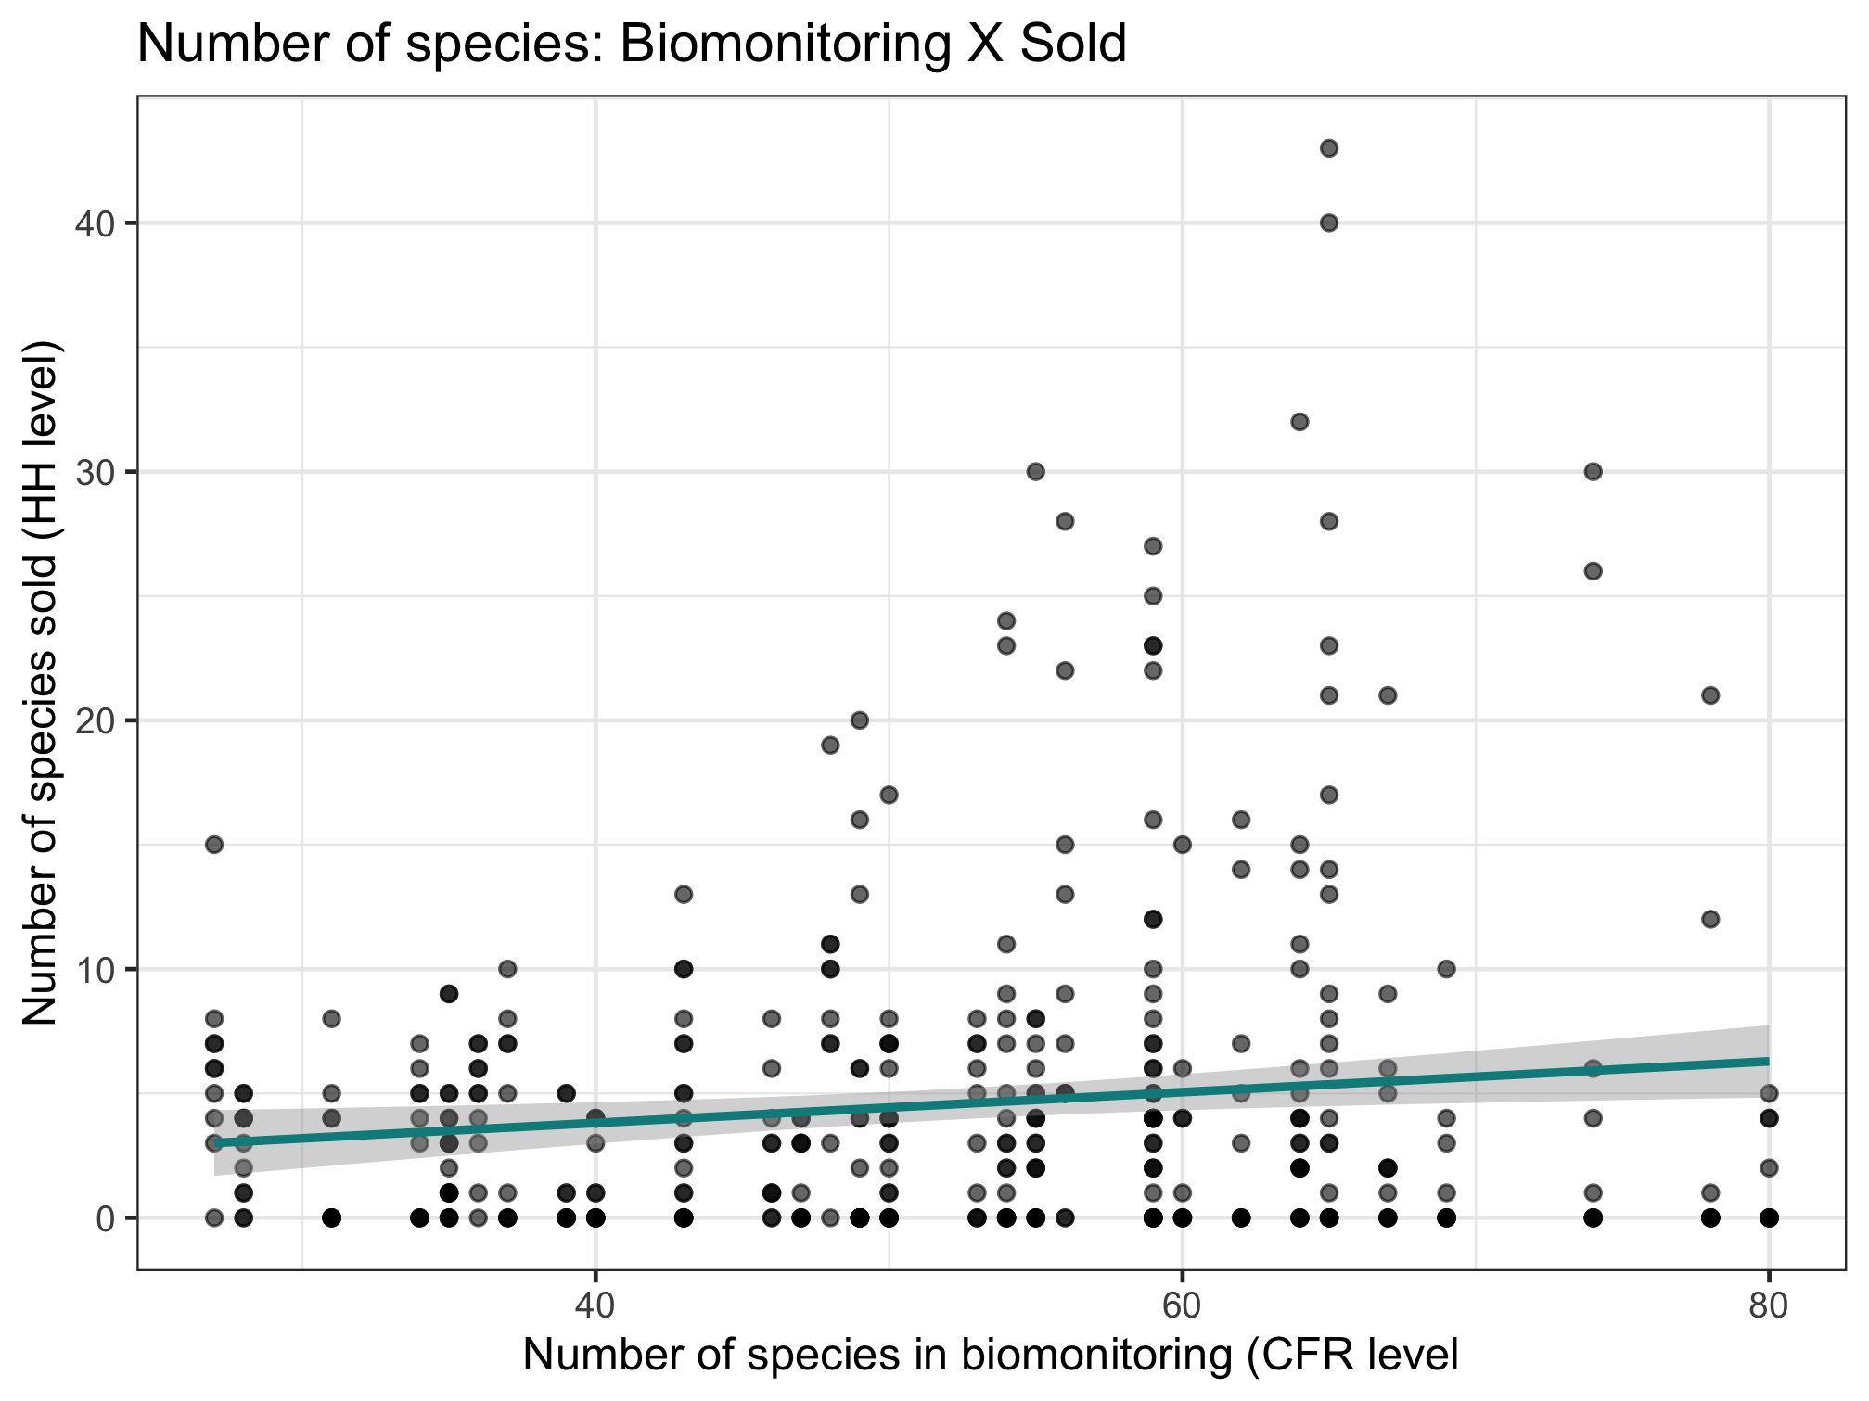

Nutrient diversity in the food system
Sold diversity
System diversity
Catch diversity
Consumption diversity
Nutrient diversity in household diets
Slope = 0.397

Slide 24
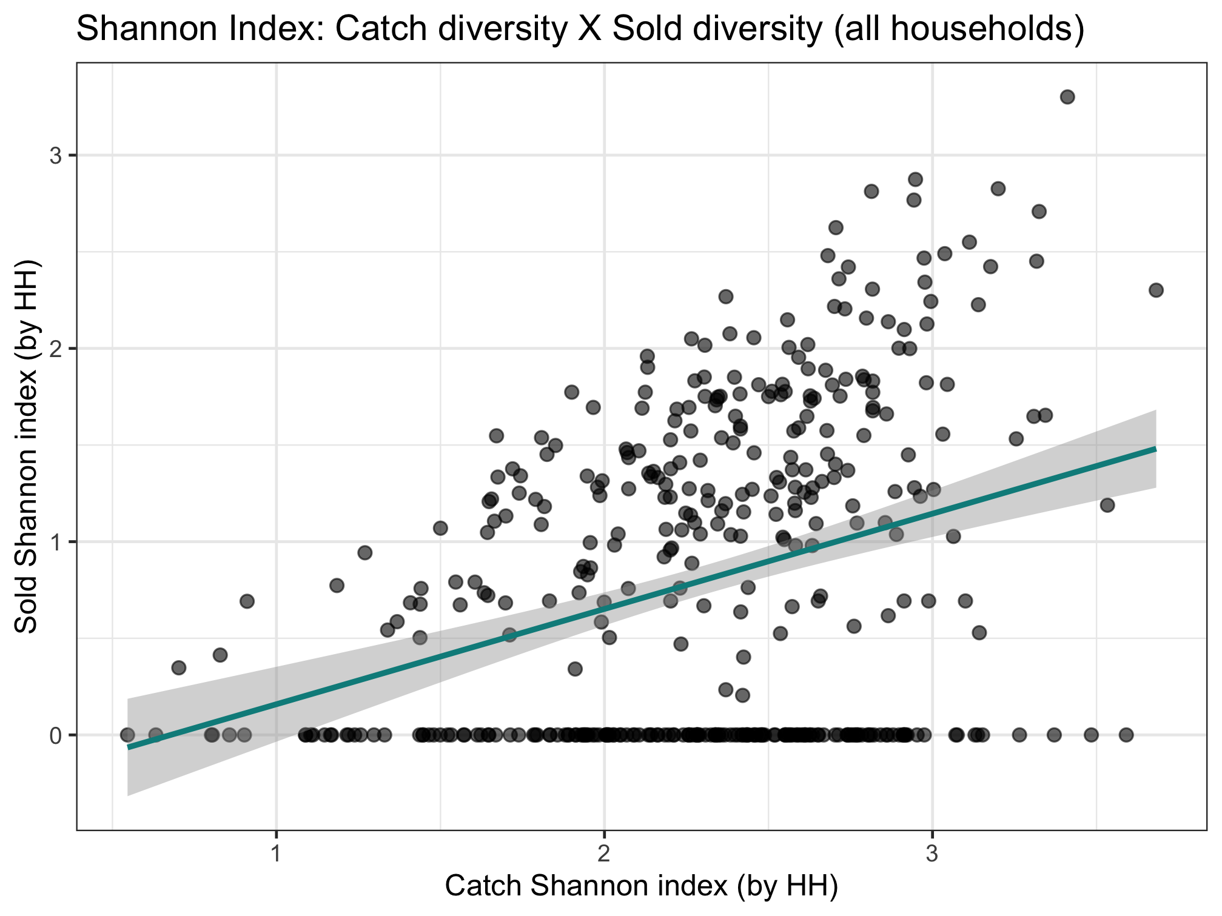
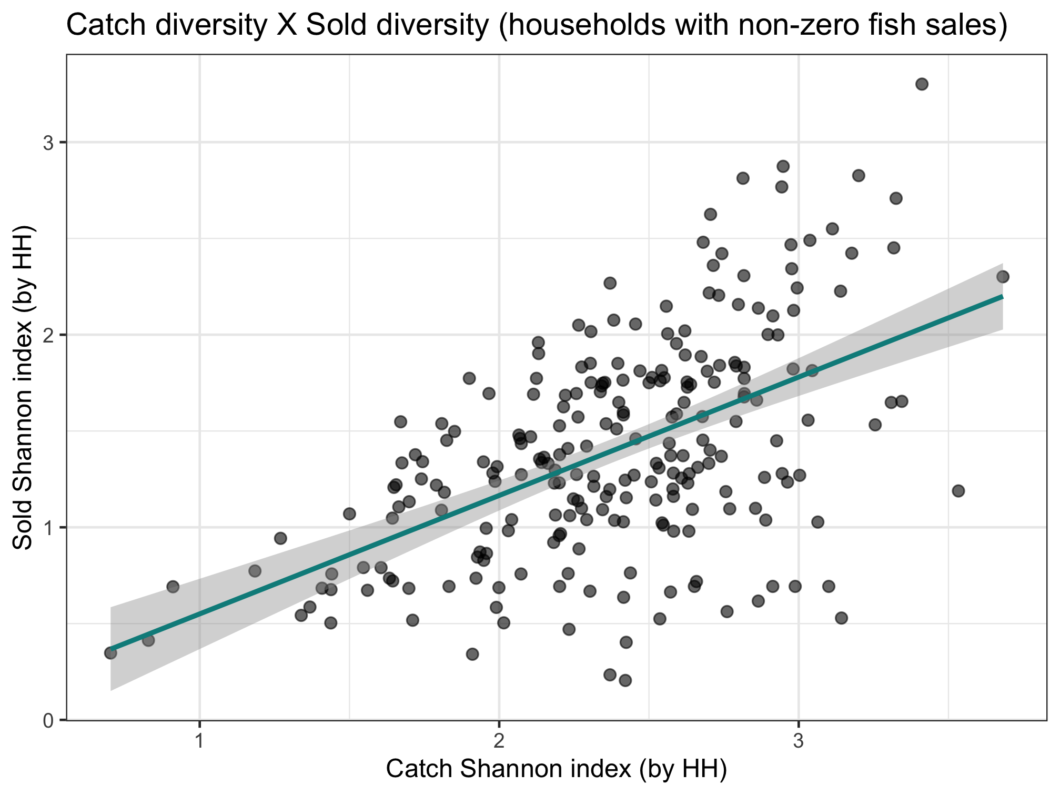
Key point:
Sold species are selective.
Catch and consumption are in lock step. Much accounting includes only sold, which isn't as linked to what is in the ecosystem. Disprefered sale species are underrecognized
Nutrient diversity in the food system
Sold diversity
Slope = 0.287
System diversity
Catch diversity
Consumption diversity
Nutrient diversity in household diets
Slope = 0.493

Slide 25
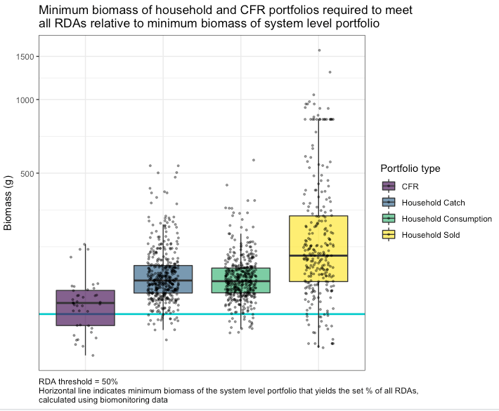
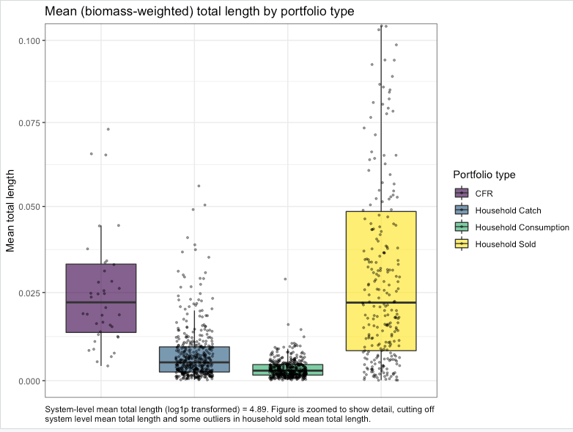
Get rid of legend. Color points by number of species.

Slide 26
New slides as of 10/27
Terminology for the next few slides
“Relationship of interest”:
Relationship 1: System diversity and catch diversity
Relationship 2: Catch diversity and consumption diversity
Relationship 3: Catch diversity and sold diversity
“Specifications”:
Four specifications:
Base (no controls)—just core predictor in relationship of interest
HH characteristics
Add market distance
Interact market distance
I only show two tables in the next few slides as examples, but I have run all combos of relationships of interest and specifications using species count and Shannon index (12 tables total) and can show you anything you’re interested in. For all relationships of interest, I test whether different specifications change the magnitude of the coefficient on the core predictor across specifications (spoiler: they never do).

Slide 27
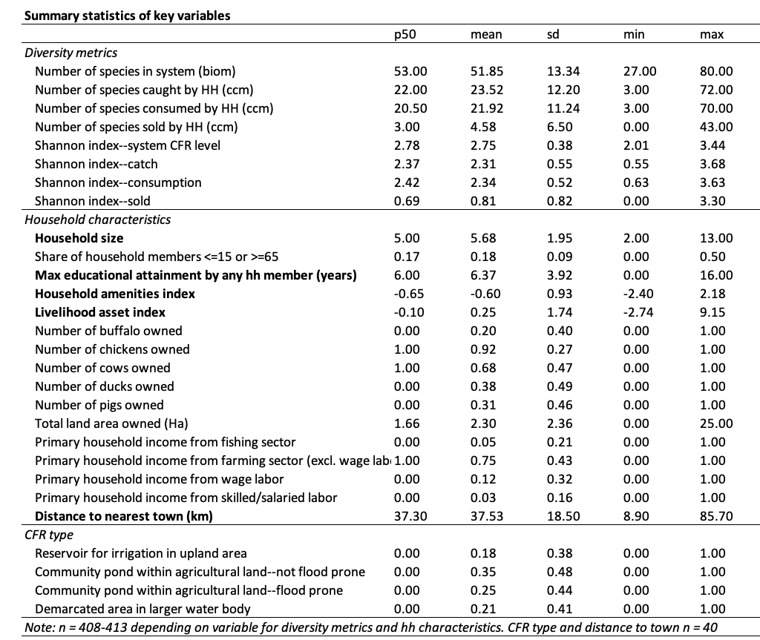
Household characteristics included in current models (bold in table):
Number of household members (household size)
Maximum educational attainment of any household member in years
Household amenities asset index (housing materials etc)
Livelihood asset index (includes fishing gear, agricultural equipment, etc)
Distance to nearest city (among Battambang, Pursat, Kampong Thom and Siem Reap) as a proxy for distance to market.

Slide 28
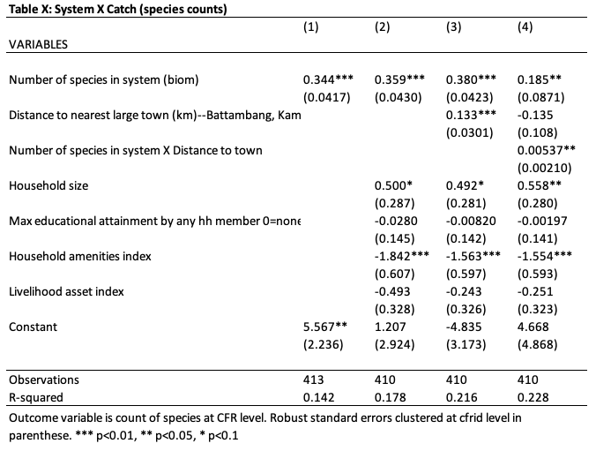
Model example: Relationship 1--System diversity and catch diversity as measured by species counts
Specification (each specification below repeated for each relationship of interest):
Base (no controls)—just core predictor
HH characteristics
Add market distance
Interact market distance
As we add covariates, our explanatory power increases (R2) but this does not attenuate or enhance the effect of core predictor.
All coefficients on core predictors are not statistically different across the 4 specifications (true for each relationship of interest).
Interaction is significant (see next slide)
Table on left is repeated for each relationship of interest (catch x system, cons x catch, sold x catch) and patterns described above are similar.

Slide 29
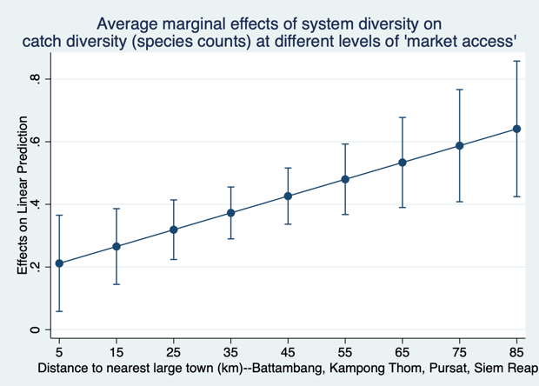
Interaction:
The “effect” of system diversity on catch diversity increases with distance from town.
When number of species in the system increases by 1, the increase in number of species caught ranges from 0.21 to 0.64.

Slide 30
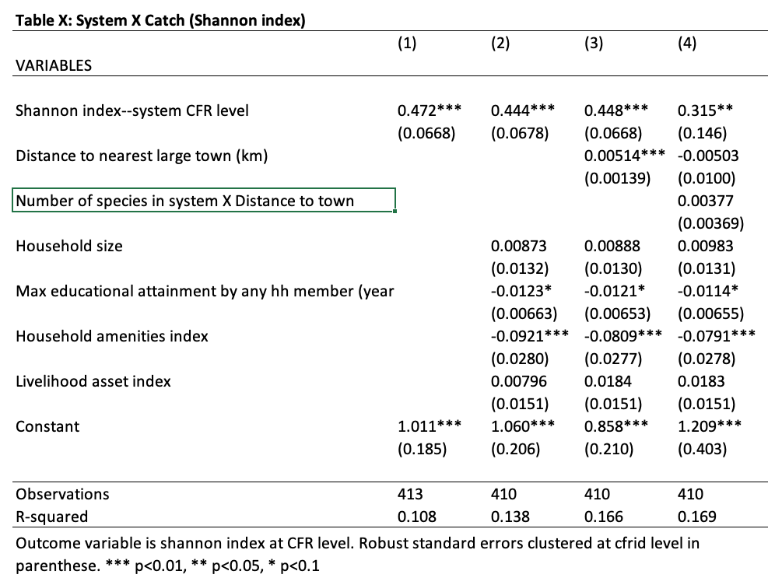
Model example: Relationship 1--system diversity and catch diversity as measured by Shannon index
Initial patterns for Shannon index are roughly similar to species counts.
All coefficients on core predictors are not statistically different across the 4 specifications (and all three relationships of interest)

Slide 31
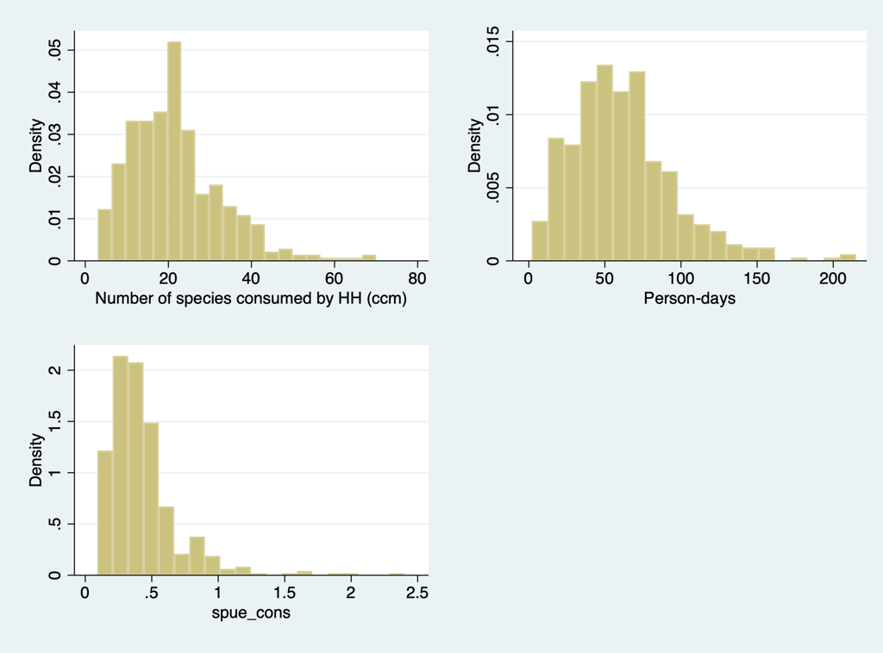
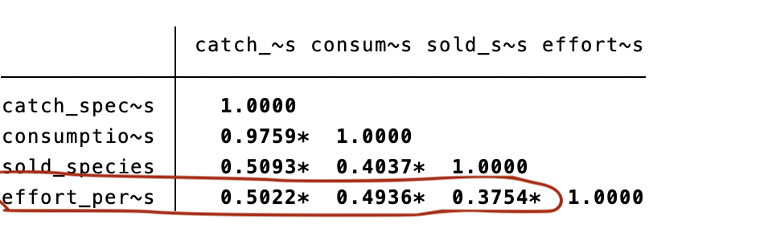
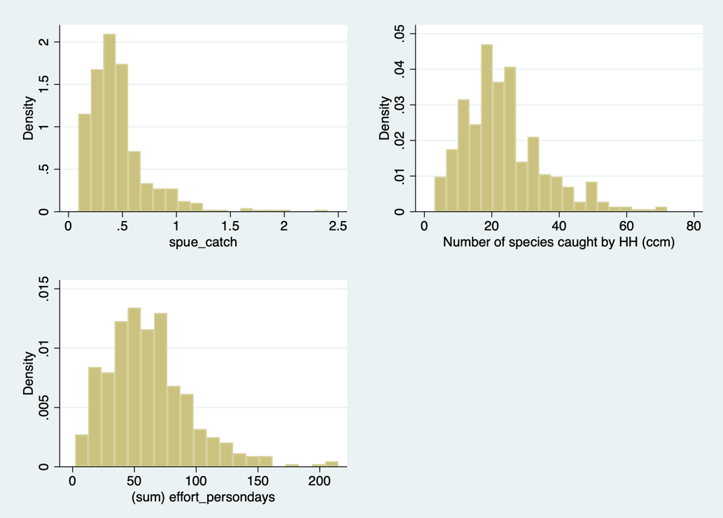
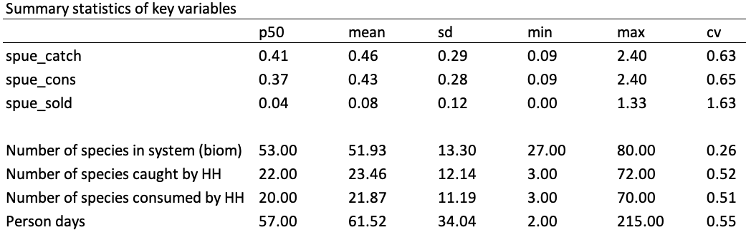
Species-per-unit-effort questions
Lots of correlation between effort and number of species caught/consumed/sold

Slide 32
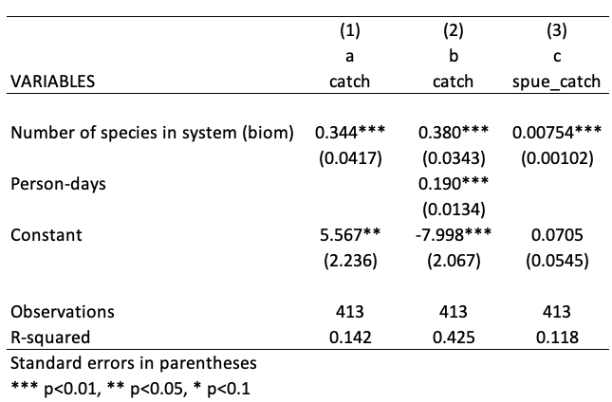

Explanatory power of model c lower because variation associated with effort has been removed from dependent variable.
How do you interpret the coefficient circled in orange? When the number of species in the biomonitoring data goes up by 1, the catch per person-day by households goes up by 0.00754 species?
Interpretation-wise, I don’t like that the units are different for system diversity and catch diversity so I generally prefer the second model.

Slide 33
Past graphs and notes…

Slide 34
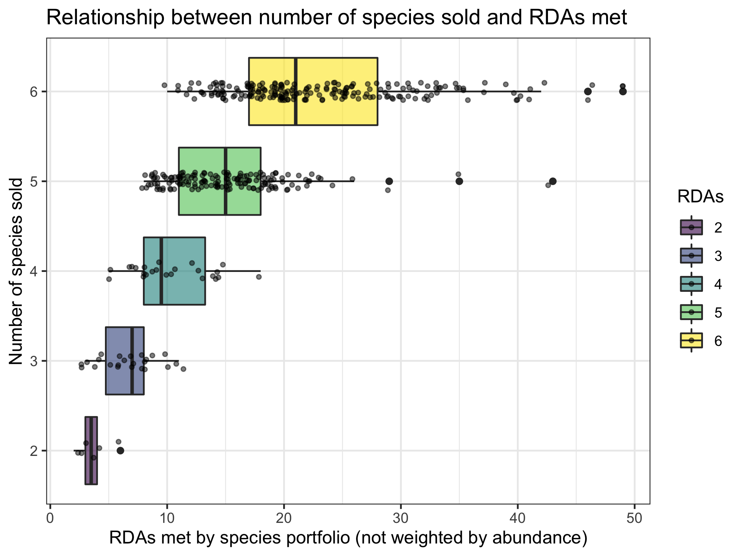
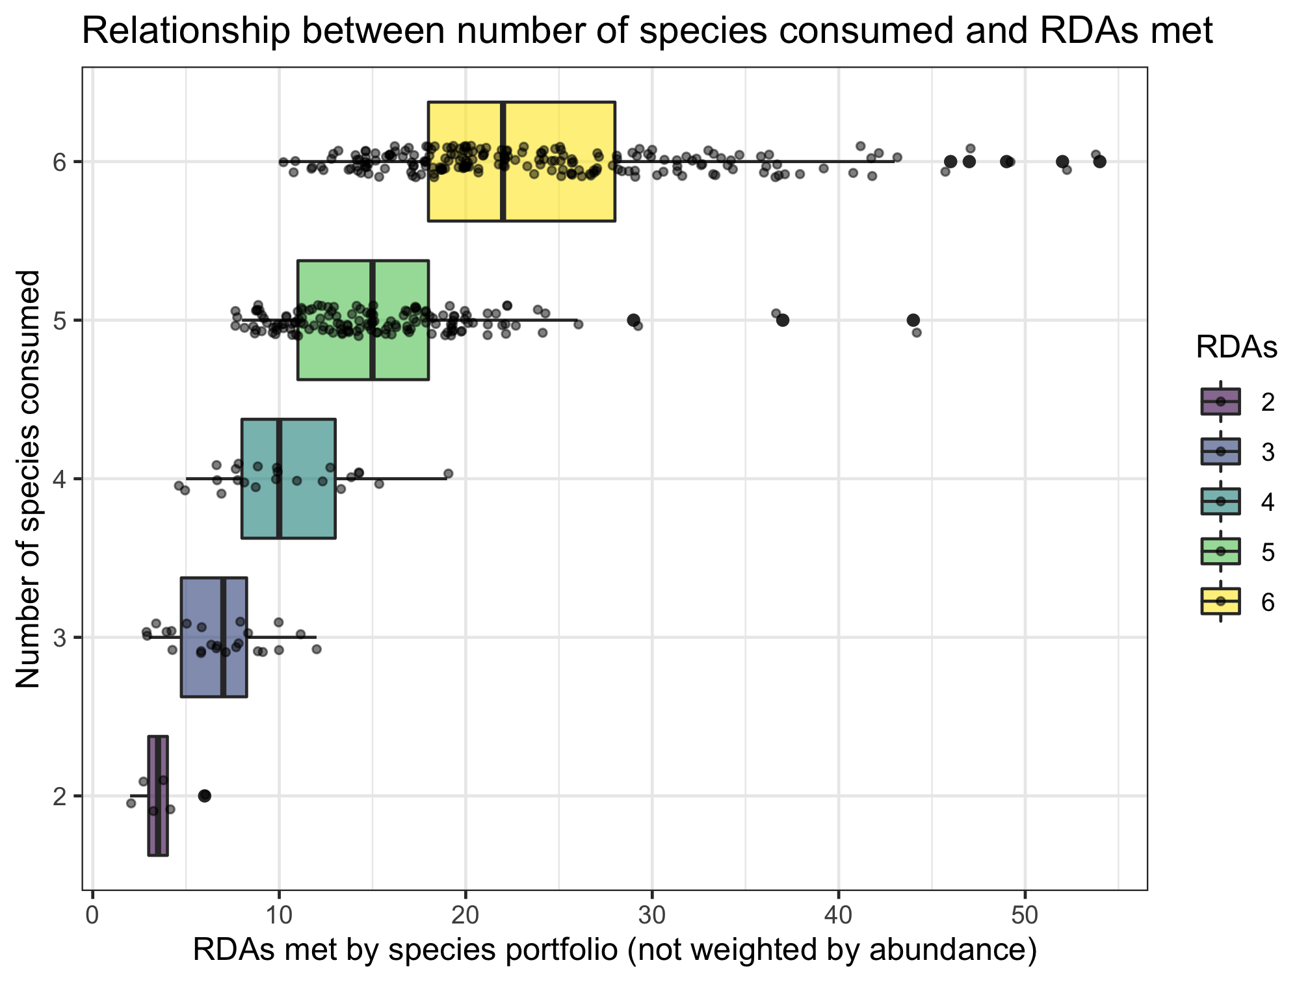
Nutrient diversity in the food system
Sold diversity
System diversity
Catch diversity
Consumption diversity
Nutrient diversity in household diets
Slopes if RDAs treated as continuous:
0.701 (sold)
0.697 (consumed)

Slide 35
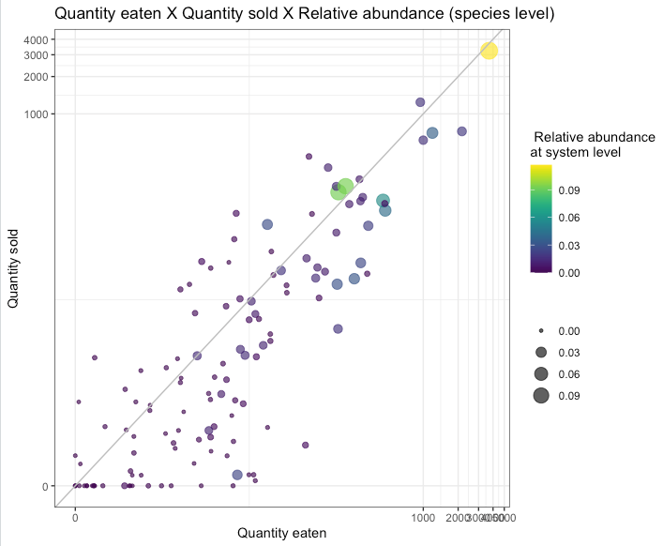
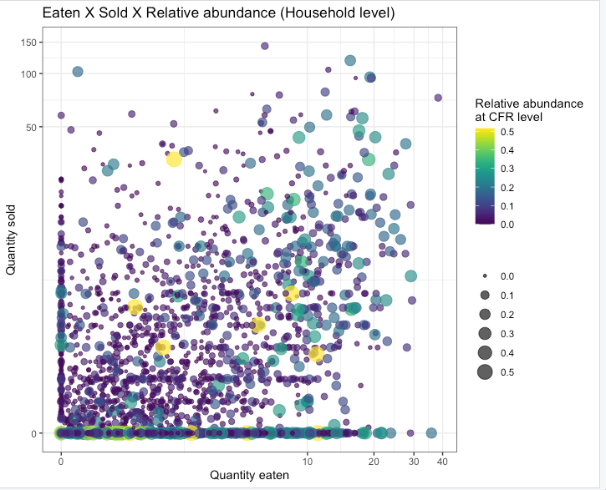
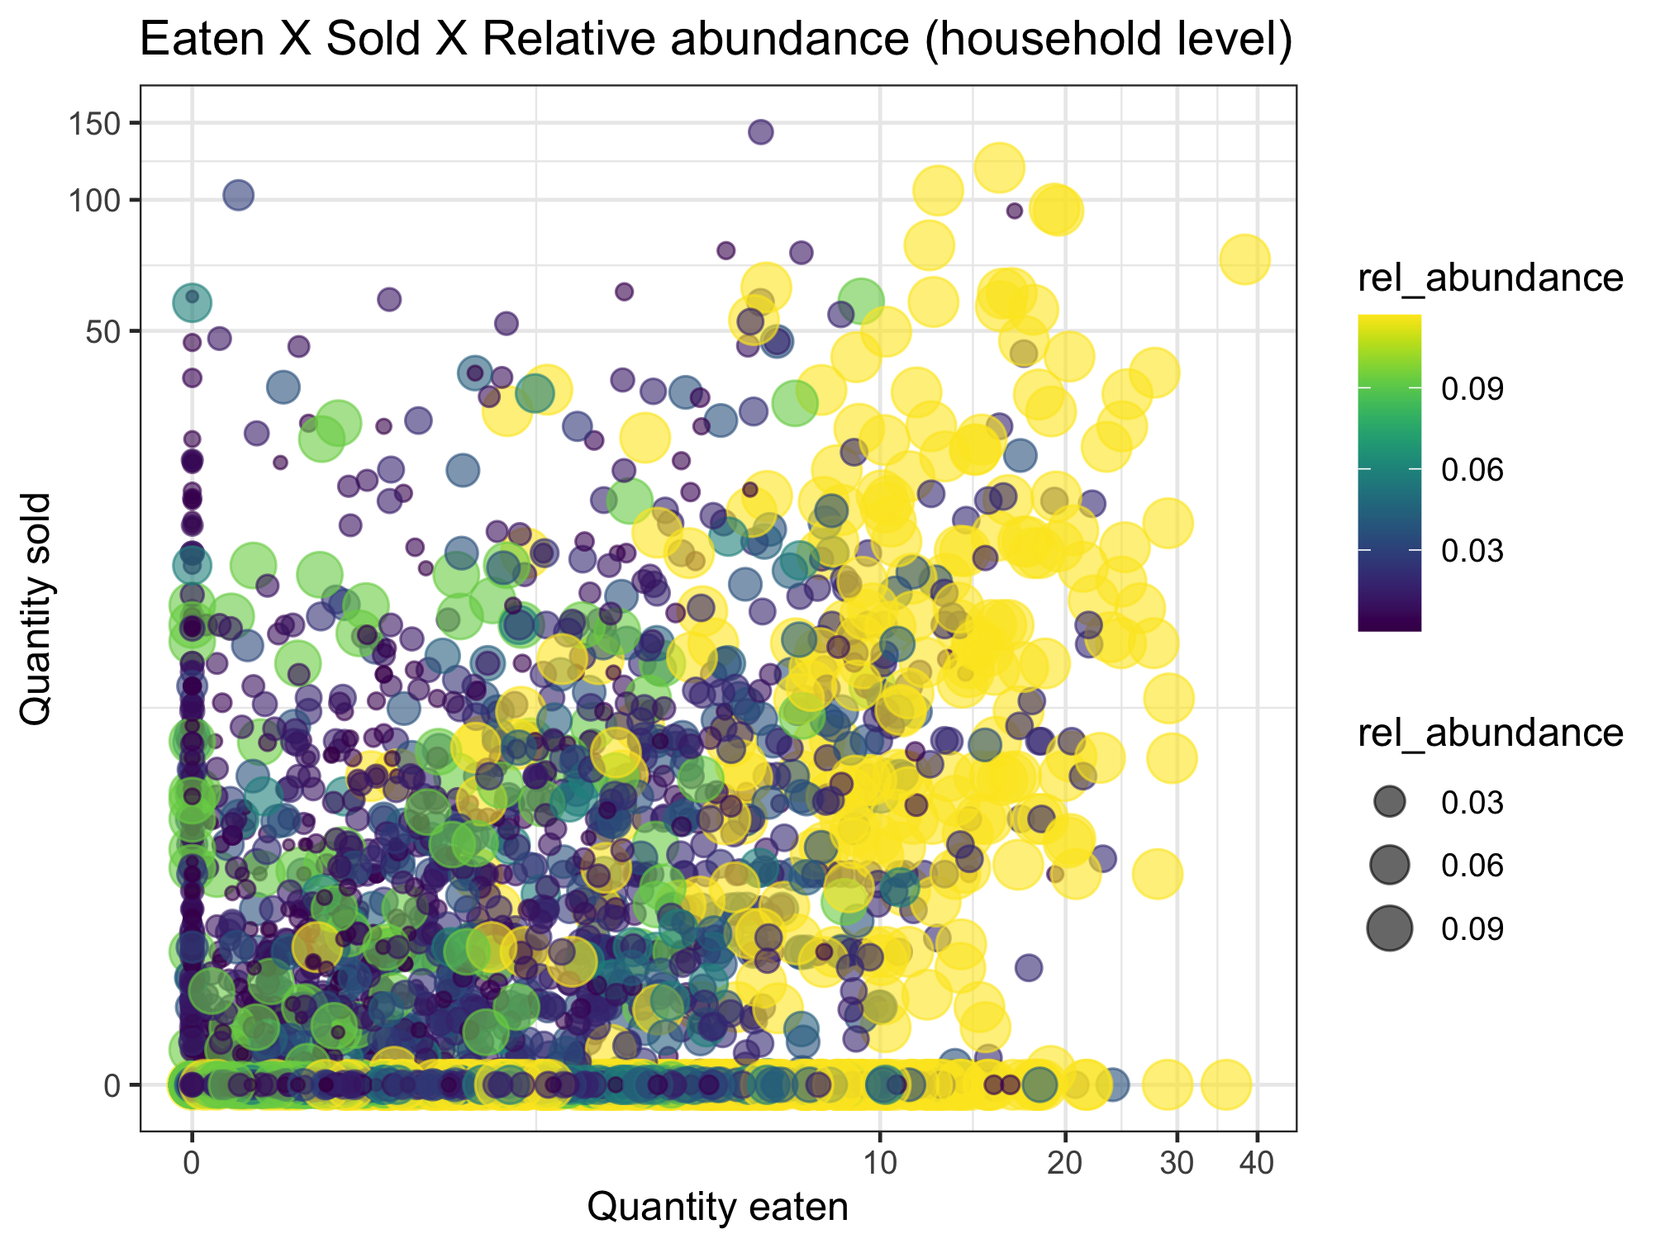
This uses relative abundance at the system level.
Nutrient diversity in the food system
Sold diversity
System diversity
Catch diversity
Consumption diversity
Nutrient diversity in household diets
Conclusion: abundance doesn’t necessarily drive sale or consumption

Slide 36
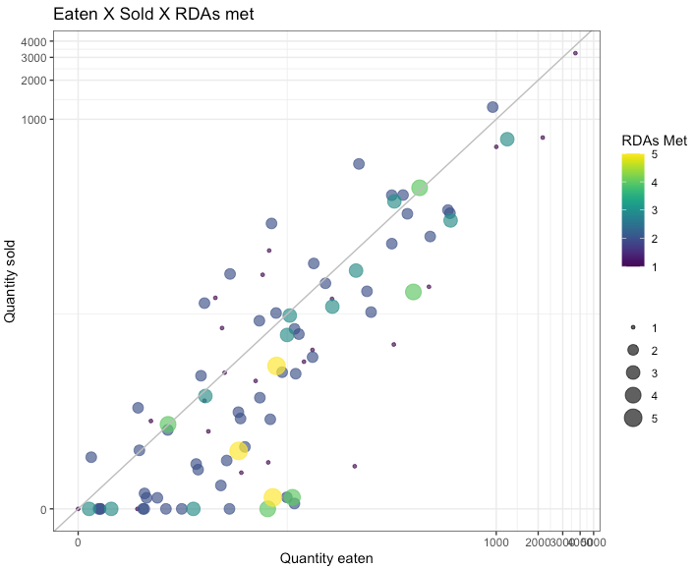
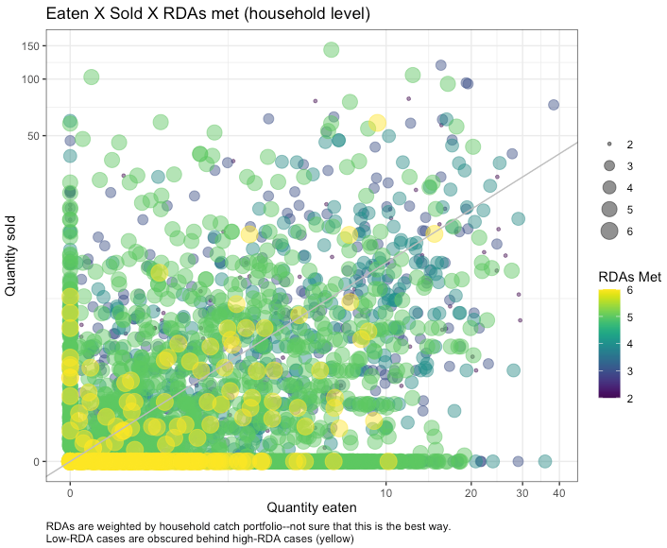
Nutrient diversity in the food system
Sold diversity
System diversity
Catch diversity
Consumption diversity
Nutrient diversity in household diets
Is this a small fish effect?
Yellow (high RDA) means whatever the last nutrient is (VitA or calcium (small fish)
We wanted to weight the RDAs by relative abundance, but within which portfolio level? These are weighted by household-level catch portfolio. Need to think more about the implications of this.
Low-RDA fish are obscured by high-RDA fish. Sorting differently doesn’t help much, but highlights that there are many low-RDA fish along the X axis.
Maybe this should be plotted at a higher level (e.g. CFR?)

Slide 37
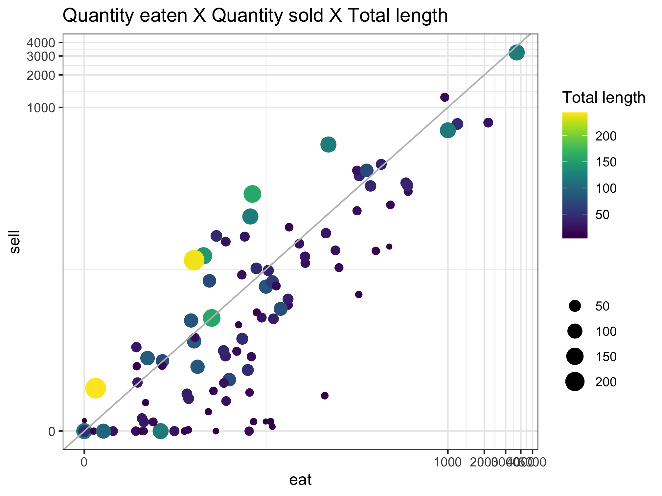
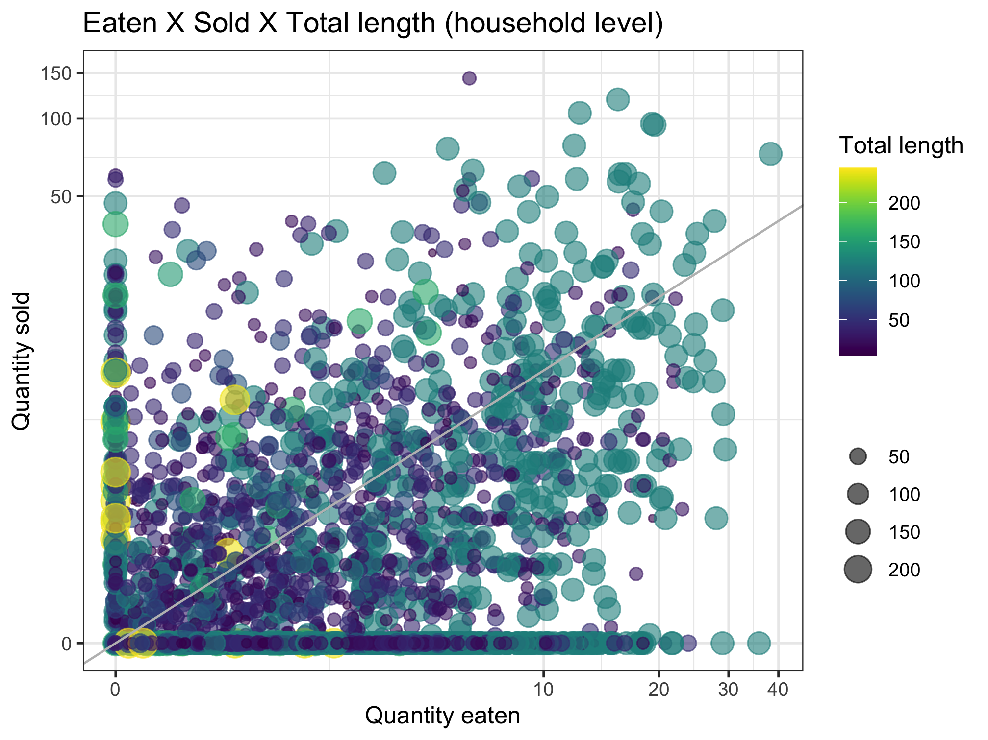
Nutrient diversity in the food system
Sold diversity
System diversity
Catch diversity
Consumption diversity
Nutrient diversity in household diets

Slide 38
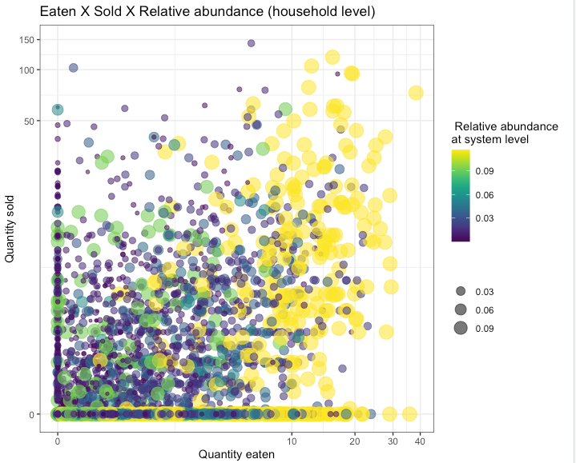
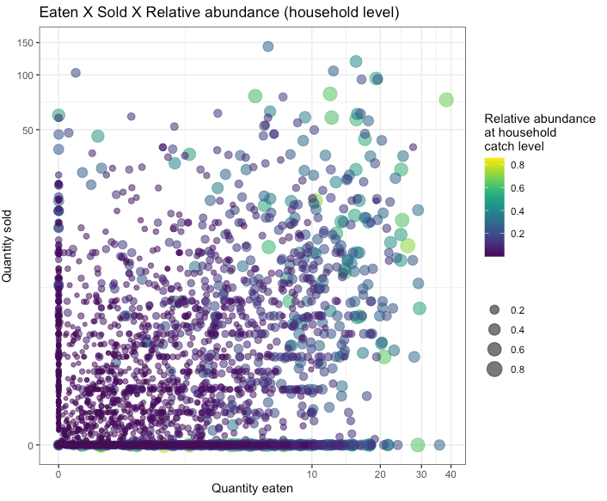
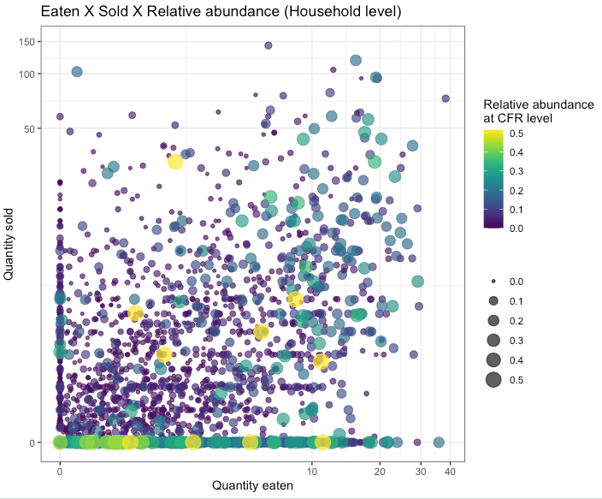
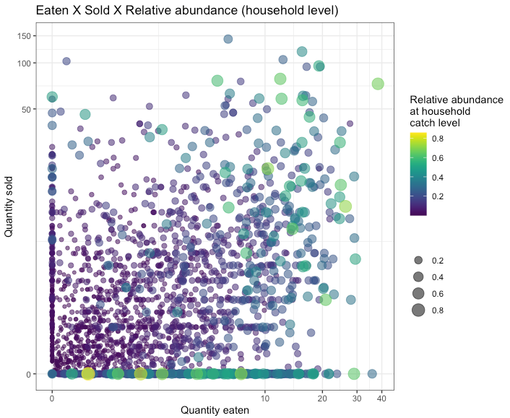
Question: Does species abundance matter for the decision between selling and eating?
Relative abundance in the system
Relative abundance in CFR
Relative abundance in household catch
More abundant species appear to be eaten more than sold. Scatter plots may not tell whole story.
Next slide unpacks this further.
Same as above, but with reverse sorting so high abundance is more visible
Same as above, but with reverse sorting so high abundance is more visible

Slide 39
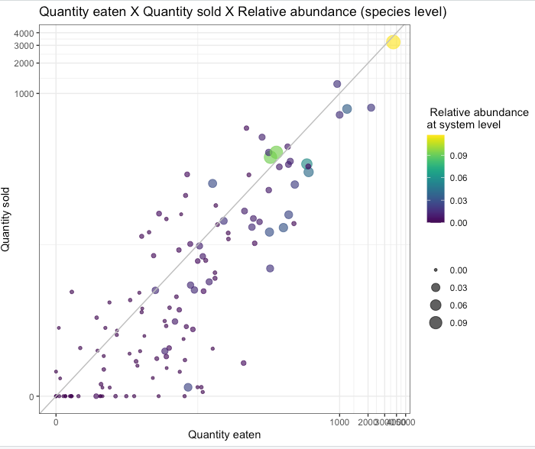
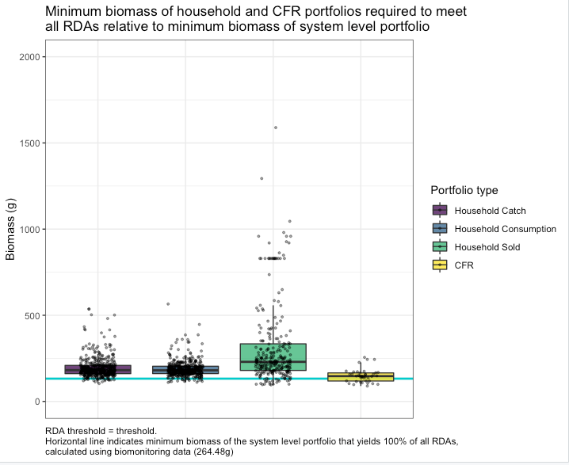
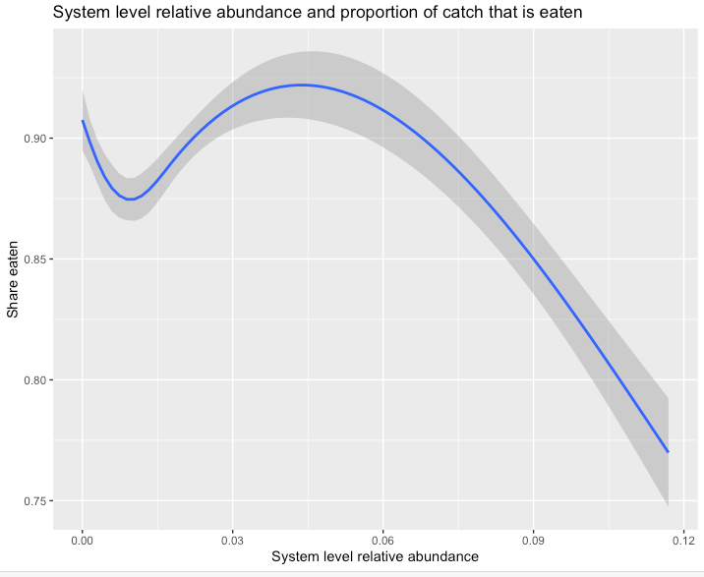
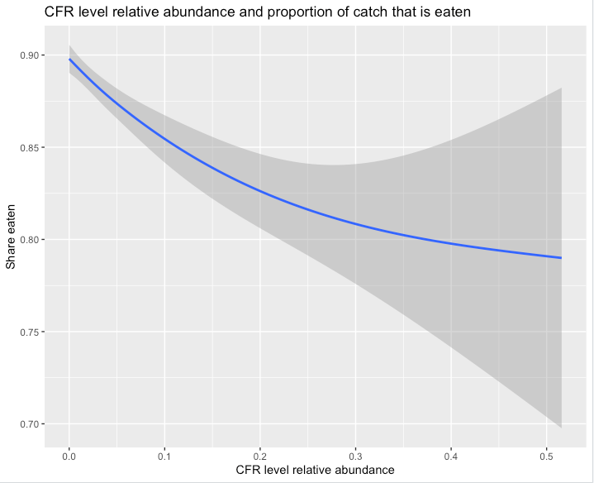
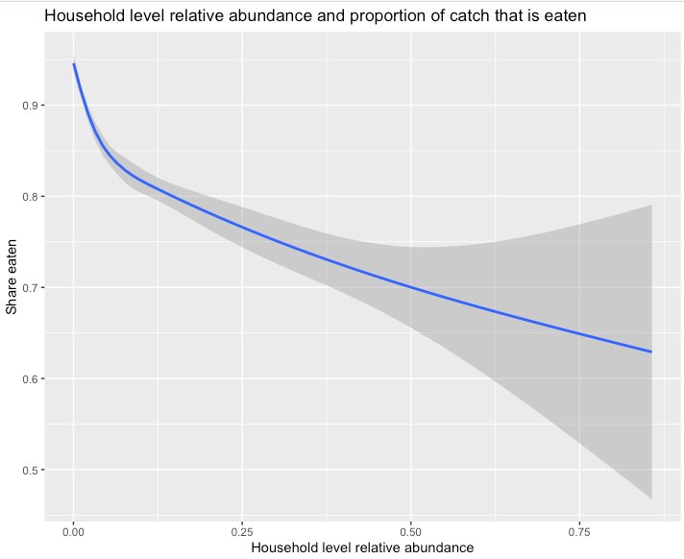
Question: Does species abundance matter for the decision between selling and eating?
Relative abundance in the system
Relative abundance in CFR
Relative abundance in household catch
Spearman correlation coefficient between abundance and share eaten = -0.107
Spearman correlation coefficient between abundance and share eaten = -0.129
Spearman correlation coefficient between abundance and share eaten = -0.275

Slide 40
Sebastian’s thoughts 20220929
Nestedness is a method
Filtering is a process
Framing should be around filtering, with nestedness as a tool that we might use to understand it
“Community assembly to understand the filters that apply from fish available in the environment to fish available on people’s plates”

